Slide 1


ZenSar Technologies
In Plant Training

Slide 2
In Plant Training
In Plant Training for students to enrich their knowledge on Software ,Hardware and Networking.
Provide them exposure in real time Industry Knowledge.
Trainers are delivering a relevant and guided learning skill that combines Lecture and practice to deliver what you need to know about a product or technology.

Slide 3

Objective of the Training
To enrich the student knowledge in :
->Hardware
->Networking
->Embedded systems
->Android Database
->Software Platforms

Slide 4

ZenSar Technologies Services
Analytics

Slide 5

ZenSar Technologies Services
Cloud and Infrastructure

Slide 6

ZenSar Technologies Services
Digital Experience

Slide 7

ZenSar Technologies
Software Testing

Slide 8

ZenSar Technologies
Enterprise Application

Slide 9
Overview of the Internship
Java and its applications.
MySql Database
Html ,XML.
Sql with Javascript.
Projects:
-> Dream Soccer League-IT IS A JAVA BASED WEB APPLICATION DESIGNED BY THE B.TECH SEM VII STUDENTS OF BHARATI VIDYAPEETH (DEEMED TO BE) UNIVERSITY COLLEGE OF ENGINEERING PUNE, DURING THE SUMMER INTERNSHIP EMPLOYEE SKILL DEVELOPMENT PROGRAMME.
THIS PROJECT CONSTITUTES THREE MODULES:
1. ADMIN MODULE
2. TEAM MODULE
3. USER MODULE
Role-To create HTML FORMS,JSP,FILTER and XML files.

Slide 12
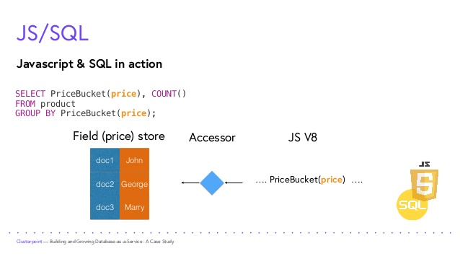

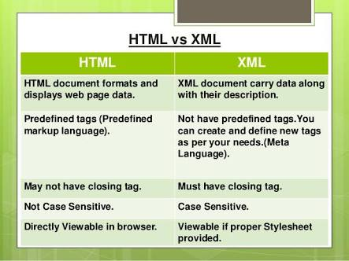

Slide 13
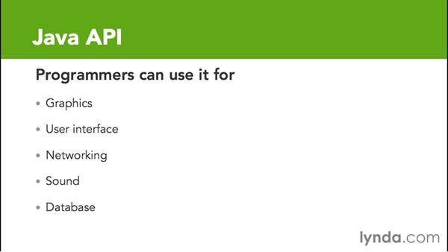

Slide 14
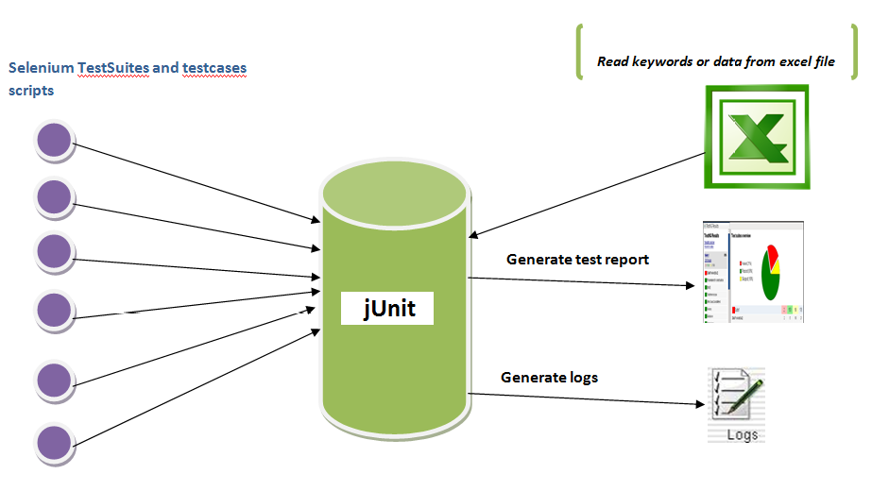

Slide 15
Challenges and Achievement
Challenges
Professional Environment
New Technology
Requirements
Achievement
Java, Java API
Junit(Test cases)
Data structures in Java
MySql Database

Slide 16
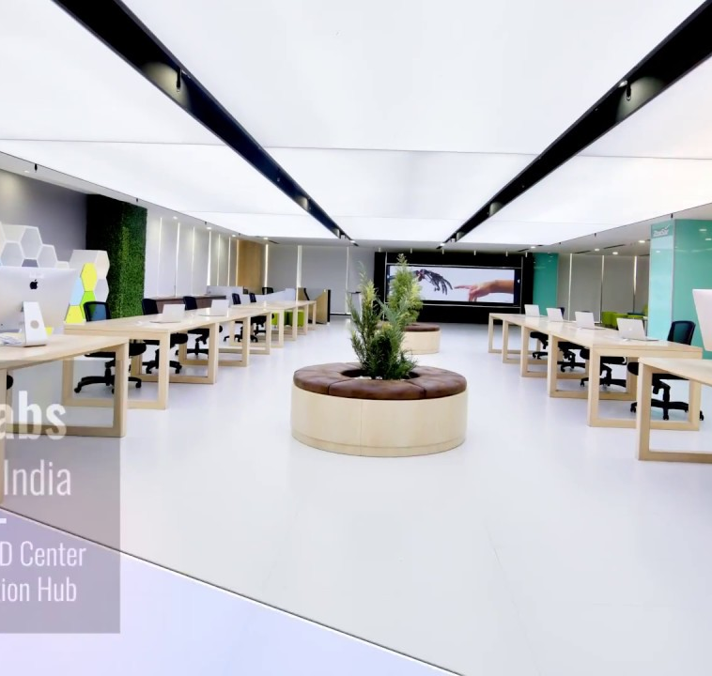

Conclusion
Industrial Training program in ZenSar Technologies had given opportunities to trainee to prepare themselves as future IT experts.
ZenSar Technologies has a lot of dedicated employees who are willing to make this industrial training program a success.
They have a high on time completion success rate of the project that resonates positively with the customer and makes them a trusted company to work with.

